Slide 1
Ensemble Adversarial Training
Attacks and Defenses
IBM Thomas J. Watson Research Center
August 7th 2017
Florian Tramèr
Stanford University
Joint work with
Alexey Kurakin (Google Brain)
Nicolas Papernot (PSU)
Dan Boneh (Stanford)
Patrick McDaniel (PSU)

Slide 2
Adversarial Examples in ML
(Goodfellow et al. 2015)
Goal: find r such that f(x+r) ≠ f(x) and ⃦r ⃦ ≤ ε

Slide 3
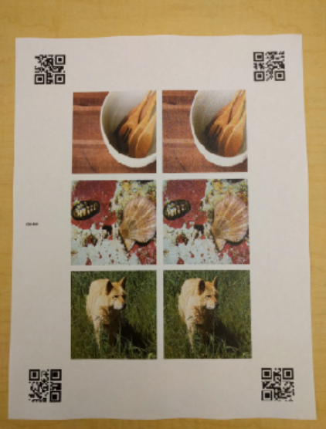
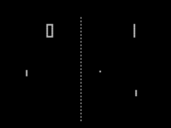
Adversarial Examples in ML
Images
Szegedy et al. 2013, Nguyen et al. 2015,
Goodfellow et al. 2015, Papernot et al. 2016,
Liu et al. 2016, Kurakin et al. 2016, …
Physical-World Attacks
Sharif et al. 2016, Kurakin et al. 2017,
Evtimov et al. 2017
Malware
Šrndić & Laskov 2014, Xu et al. 2016,
Grosse et al. 2016, Hu et al. 2017
Text Understanding
Papernot et al. 2016, Jia & Liang 2017
Reinforcement Learning
Huang et al. 2017, Lin et al. 2017,
Behzadan & Munir 2017
Notes:
Lujo Bauer => Milla Jovovich

Slide 4

Threat Model: White-Box Attacks
ground truth
ML Model
bird
Loss
tree
plane
Take gradient of the loss
“Fast Gradient Sign Method” (FGSM)

Slide 5
Threat Model: White-Box Attacks
ML Model
bird
+
tree
plane
“Fast Gradient Sign Method” (FGSM)

Slide 6



Threat Model: Black-Box Attacks
ML Model
ML Model
plane
plane
ML Model
plane
Adversarial Examples transfer

Slide 7

Defenses?
Ensembles?
Preprocessing (blurring, cropping, etc.)
Distillation?
Generative modeling?
Adversarial training? Lets see…
Notes:
Model the distribution of real inputs

Slide 8



Adversarial Training
ML Model
Loss
bird
attack
ML Model
Loss
plane

Slide 9
Attacks on “One-Shot” Adversarial Training
Adversarial examples transferred from another model

Slide 10

Gradient Masking
How to get robustness to FGSM-style attacks?
Large Margin Classifier
“Gradient Masking”

Slide 11
Loss of Adversarially Trained Model
Adversarial Example
Non-Adversarial Example
Move in direction of another model’s gradient
(black-box attack)
Move in direction of model’s gradient
(white-box attack)
Data Point

Slide 12
Loss of Adversarially Trained Model
Notes:
Gradient models local evolution of the loss, doesn’t generalize

Slide 13
Simple Attack: RAND+FGSM
Small random step
Step in direction of gradient

Slide 14
What’s wrong with
“One-Shot” Adversarial Training?
Minimize
Small if:
The model is actually robust
Or, the gradient points in a direction that is not adversarial
Degenerate Minimum

Slide 15
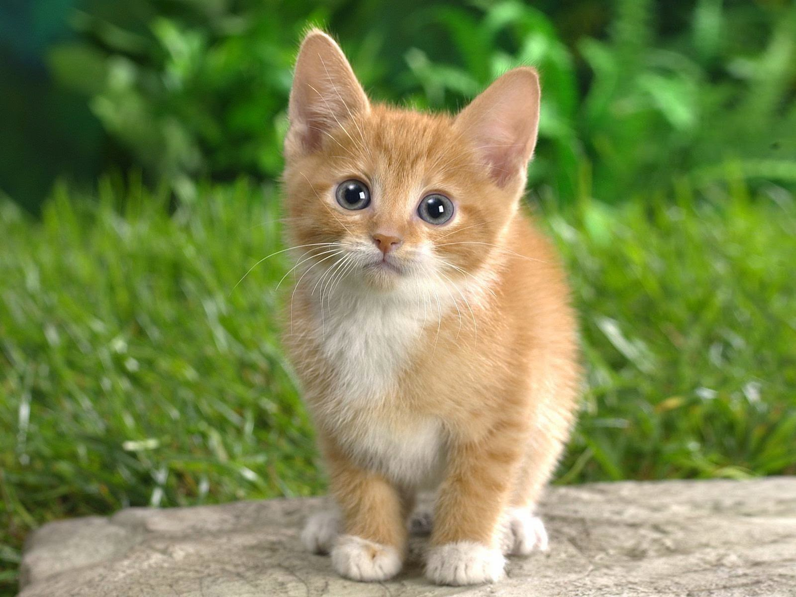
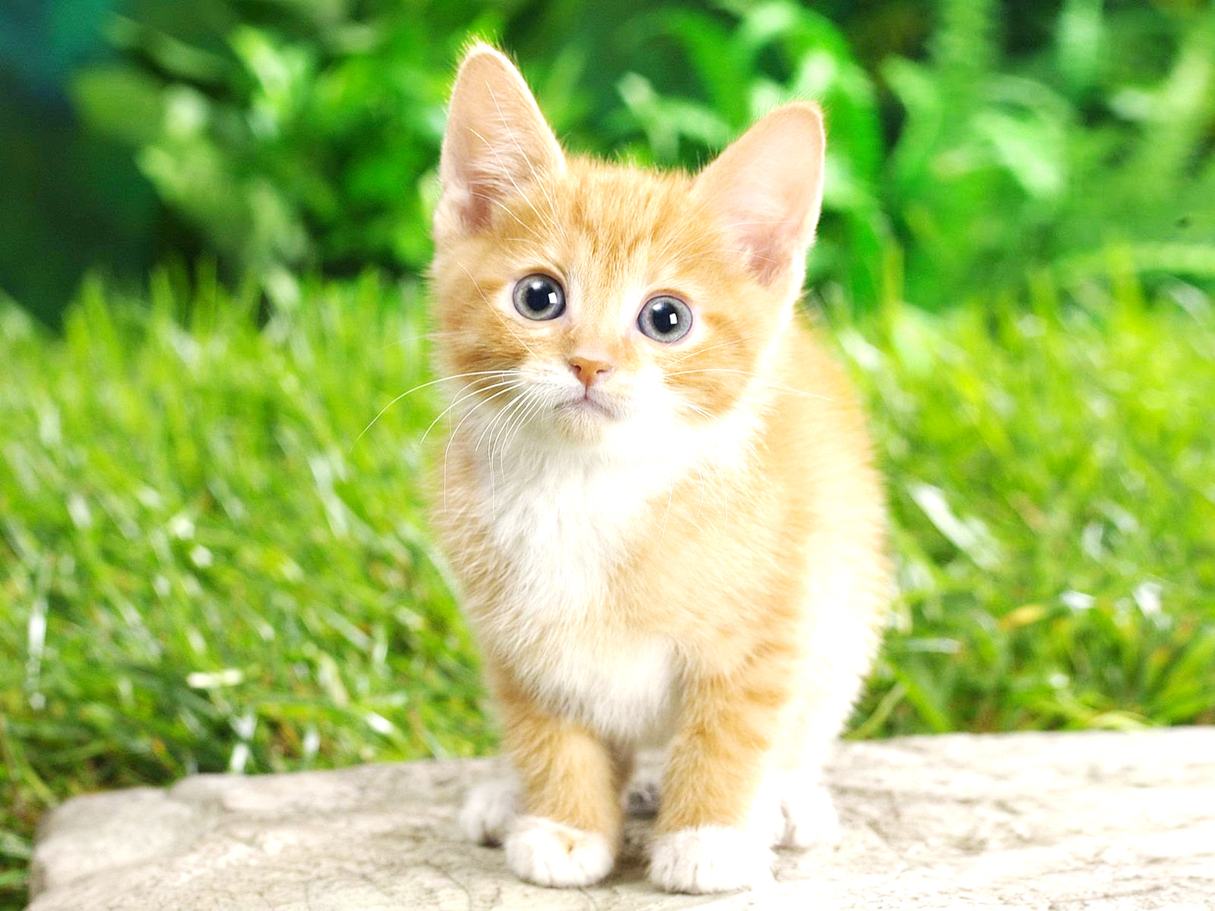

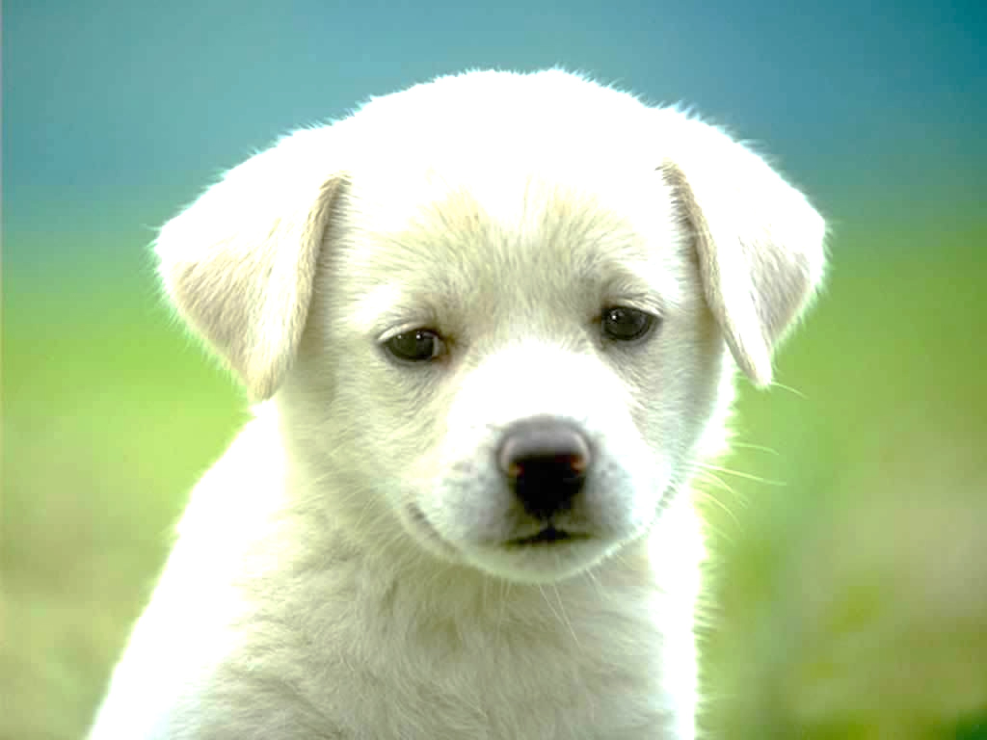
Ensemble Adversarial Training
How do we avoid these degenerate minima?
pre-trained
ML Model
ML Model
ML Model
Loss

Slide 16
Results
Source model for attack was not used during training
Less white-box FGSM samples seen during training
Notes:
No gradient masking

Slide 17
Results

Slide 18

What about stronger attacks?
Little to no improvement on white-box iterative and RAND+FGSM attacks!
But, improvements in black-box setting!

Slide 19
What about stronger attacks?

Slide 20
Efficiency of Ensemble Adversarial Training
Pre-compute gradients for pre-trained models
  Lower per-batch cost than with adversarial training
Randomize source model in each batch
  If num_models % num_batches = 0, we see the same adversarial examples in each epoch if we just rotate
Convergence can be much slower
  Standard Inception v3: ~150 epochs
  Adversarial training: ~190 epochs
  Ensemble adversarial training: ~280 epochs
Maybe because the task is actually hard?...

Slide 21
Open Problems
How far can we go with adversarial training?
  Madry et al. 2017: robustness against white-box attacks is possible!
    Caveat 1: Very expensive
    (100 epochs of training, 40x more backprop steps per epoch)
    Caveat 2: What is the right metric (l∞ , l₁ , l₂ etc.) ?
Can we say anything formal (and useful) about adversarial examples?
  Why do they exist?
  Why do they transfer?
THANK YOU

