Slide 1
Measuring and Enhancing the Security of Machine Learning
Florian Tramèr
Stanford University

Slide 2
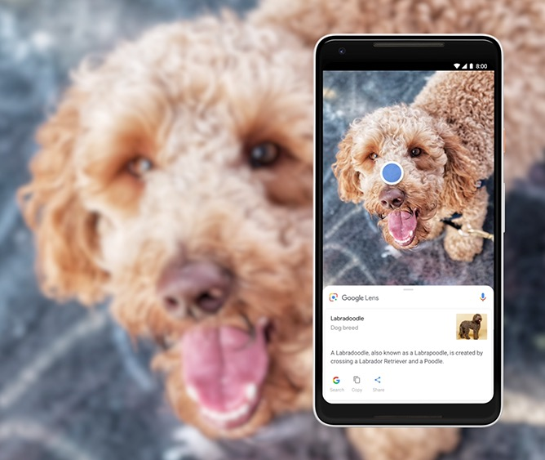
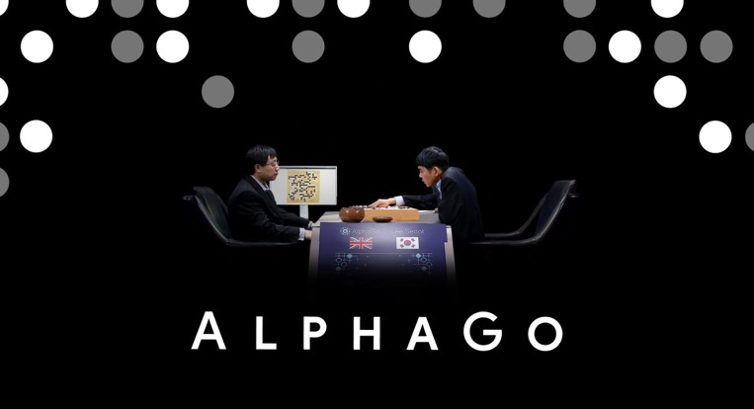

Machine learning works.

Slide 3
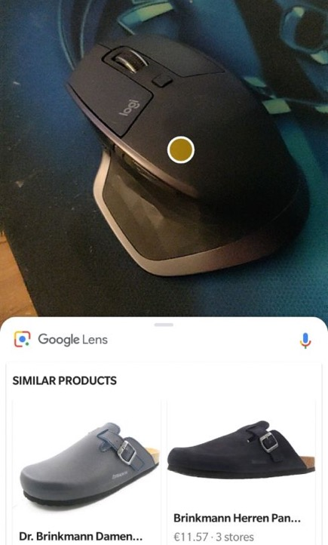
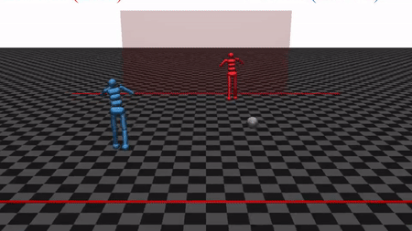
Machine learning works most of the time! many applications tolerate occasional failures
from the Bible (1 Kings 7:2)

Slide 4

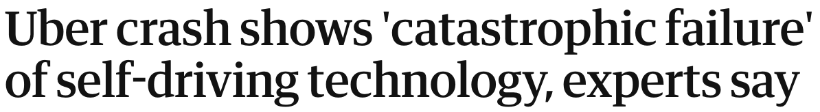
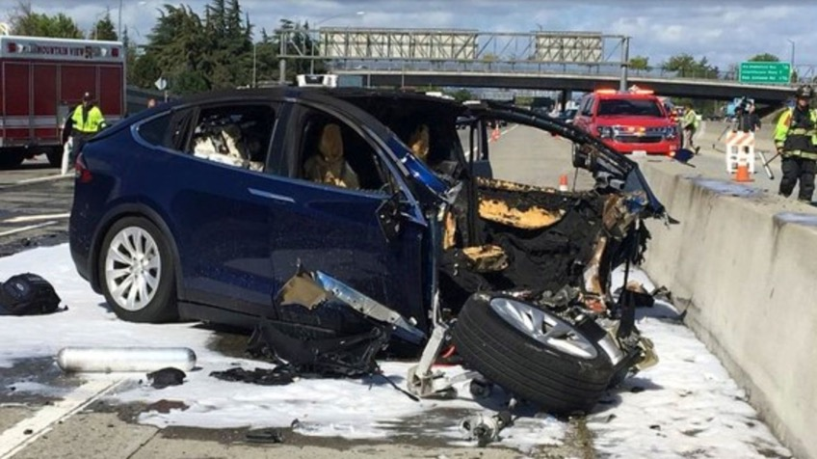
Machine learning can also fail disastrously.
Critical mistakes...

Slide 5
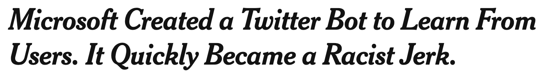
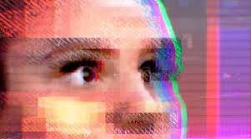
Machine learning can also fail disastrously.
Critical mistakes...
Direct attacks...

Slide 6
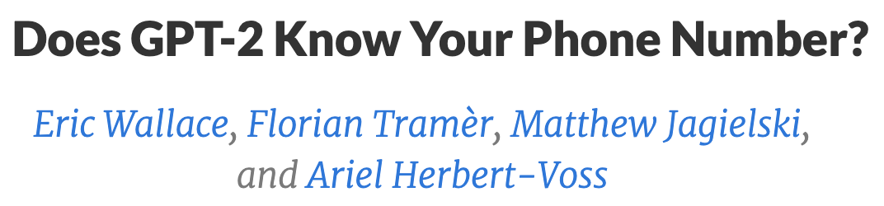
Machine learning can also fail disastrously.
Critical mistakes...
Direct attacks...
Private data leaks...

Slide 7

Challenge: understand and improve the worst-case behavior of machine learning (ML)
Approach: I study ML from
an adversarial perspective
  to improve robustness and privacy of ML in adversarial settings
  to build ML that is better

Slide 8
My work: measuring and enhancing ML security
Evaluations
Evading ML models (NeurIPS ‘20) (ACM CCS ‘19)
Influenced design changes in Adblock Plus
Extracting private data (IEEE S&P ‘21)
Defenses
Training private models (ICLR ‘21 spotlight)
Training robust models (NeurIPS ‘19 spotlight) (ICLR ‘18)
Deploying private models (ICLR ‘19 oral)
Foundations
Stealing ML models (USENIX ‘16)
Microsoft’s top 3 threats to AI systems
Threat models for evasion (ICML ‘20)

Slide 9
My work: measuring and enhancing ML security
Evaluations
Evading ML models (NeurIPS ‘20) (ACM CCS ‘19)
Influenced design changes in Adblock Plus
Extracting private data (IEEE S&P ‘21)
Defenses
Training private models (ICLR ‘21 spotlight)
Training robust models (NeurIPS ‘19 spotlight) (ICLR ‘18)
Deploying private models (ICLR ‘19 oral)
Foundations
Stealing ML models (USENIX ‘16)
Microsoft’s top 3 threats to AI systems
Threat models for evasion (ICML ‘20)

Slide 10
My work: measuring and enhancing ML security
Evaluations
Evading ML models (NeurIPS ‘20) (ACM CCS ‘19)
Influenced design changes in Adblock Plus
Extracting private data (IEEE S&P ‘21)
Defenses
Training private models (ICLR ‘21 spotlight)
Training robust models (NeurIPS ‘19 spotlight) (ICLR ‘18)
Deploying private models (ICLR ‘19 oral)
Foundations
Stealing ML models (USENIX ‘16)
Microsoft’s top 3 threats to AI systems
Threat models for evasion (ICML ‘20)

Slide 11
My work: measuring and enhancing ML security
Evaluations
Evading ML models (NeurIPS ‘20) (ACM CCS ‘19)
Influenced design changes in Adblock Plus
Extracting private data (IEEE S&P ‘21)
Defenses
Training private models (ICLR ‘21 spotlight)
Training robust models (NeurIPS ‘19 spotlight) (ICLR ‘18)
Deploying private models (ICLR ‘19 oral)
Foundations
Stealing ML models (USENIX ‘16)
Microsoft’s top 3 threats to AI systems
Threat models for evasion (ICML ‘20)

Slide 12
My work: measuring and enhancing ML security
Evaluations
Evading ML models (NeurIPS ‘20) (ACM CCS ‘19)
Influenced design changes in Adblock Plus
Extracting private data (IEEE S&P ‘21)
Defenses
Training private models (ICLR ‘21 spotlight)
Training robust models (NeurIPS ‘19 spotlight) (ICLR ‘18)
Deploying private models (ICLR ‘19 oral)
Foundations
Stealing ML models (USENIX ‘16)
Microsoft’s top 3 threats to AI systems
Threat models for evasion (ICML ‘20)

Slide 13
My work: measuring and enhancing ML security
Evaluations
Evading ML models (NeurIPS ‘20) (ACM CCS ‘19)
Influenced design changes in Adblock Plus
Extracting private data (IEEE S&P ‘21)
Defenses
Training private models (ICLR ‘21 spotlight)
Training robust models (NeurIPS ‘19 spotlight) (ICLR ‘18)
Deploying private models (ICLR ‘19 oral)
Foundations
Stealing ML models (USENIX ‘16)
Microsoft’s top 3 threats to AI systems
Threat models for evasion (ICML ‘20)

Slide 14

Adversarial examples: a curious bug in ML
[Szegedy et al. ‘13], [Biggio et al. ‘13], [Goodfellow et al. ‘14], ...
88% Tabby Cat
Adversarial noise
100% Guacamole

Slide 15
We must treat adversarial examples as a computer security problem.
In our threat analysis.
Identify deployed systems where adversarial examples can cause harms beyond misclassification
In our defense evaluations.
Evaluate robustness against adaptive adversaries

Slide 16
We must treat adversarial examples as a computer security problem.
In our threat analysis.
Identify deployed systems where adversarial examples can cause harms beyond misclassification
In our defense evaluations.
Evaluate robustness against adaptive adversaries

Slide 17
We must treat adversarial examples as a computer security problem.
In our threat analysis.
Identify deployed systems where adversarial examples can cause harms beyond misclassification
In our defense evaluations.
Evaluate robustness against adaptive adversaries

Slide 18

We must treat adversarial examples as a computer security problem.
In our threat analysis.
T, Dupré, Rusak, Pellegrino, Boneh (ACM CCS 2019)
  adversarial examples are the perfect tool to attack online content blockers
  using ML for ad-blocking can break Web security
  this work led to design changes in Adblock Plus
100M active users

Slide 19
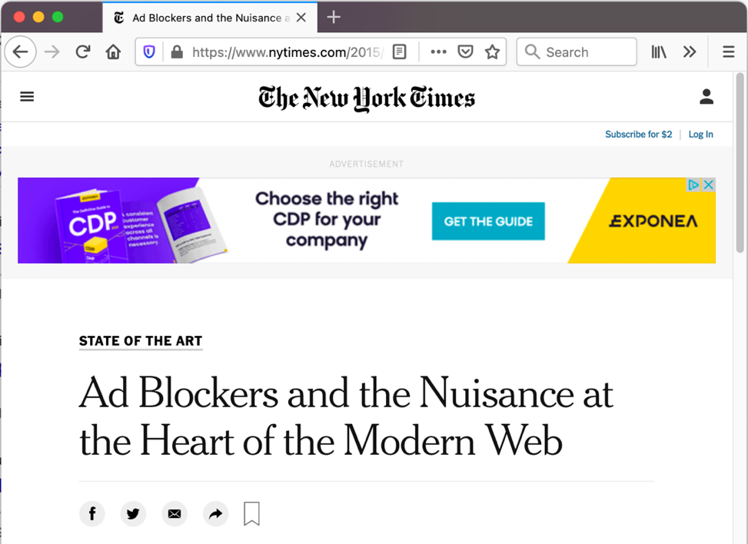

Adversarial examples are a security threat. example: online ad-blocking
publishers & advertisers want to show ads to users...
...users don’t want to see ads

Slide 20

Adversarial examples are a security threat. example: online ad-blocking
<BLOCKED>
users install ad-blockers to remove ads...

Slide 21
Adversarial examples are a security threat. example: online ad-blocking
<BLOCKED>
users install ad-blockers to remove ads...
...using machine learning!

Slide 22

An attacker can use adversarial examples to evade content blocking.
adversaries (publishers & advertisers) modify content to evade blocking...
...without changing the user’s visual perception of ads

Slide 23
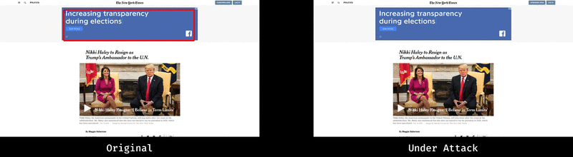
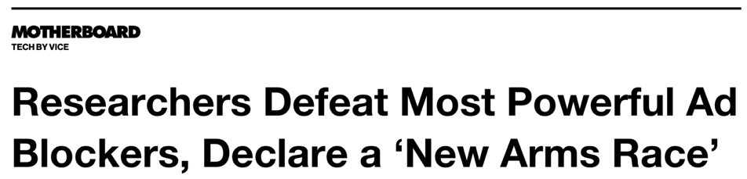
For now, the adversary wins!
“AdVersarial: Perceptual Ad Blocking meets Adversarial Machine Learning”, ACM CCS 2019

Slide 24
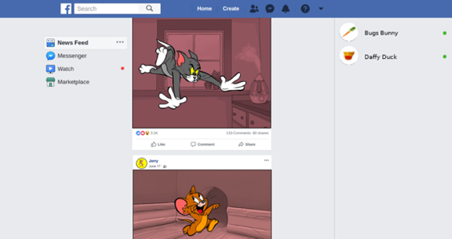
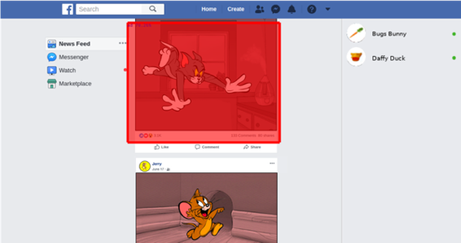

Adversarial examples can cause harm beyond model evasion.
Adblock Plus wants to run a ML model on screenshots of your entire Facebook feed.
AD
… so that Tom’s post gets blocked
Jerry uploads
malicious content
…
“AdVersarial: Perceptual Ad Blocking meets Adversarial Machine Learning”, ACM CCS 2019

Slide 25
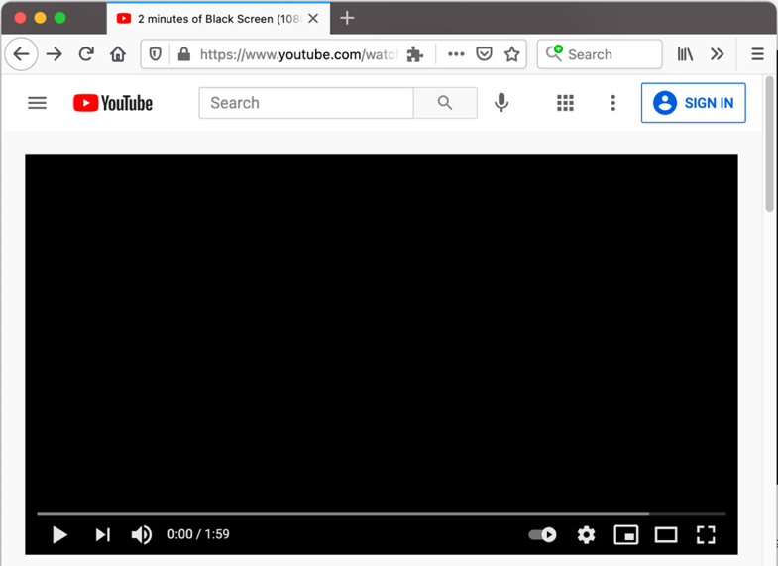


Adversarial examples are a security threat. example: blocking undesired content

Slide 26
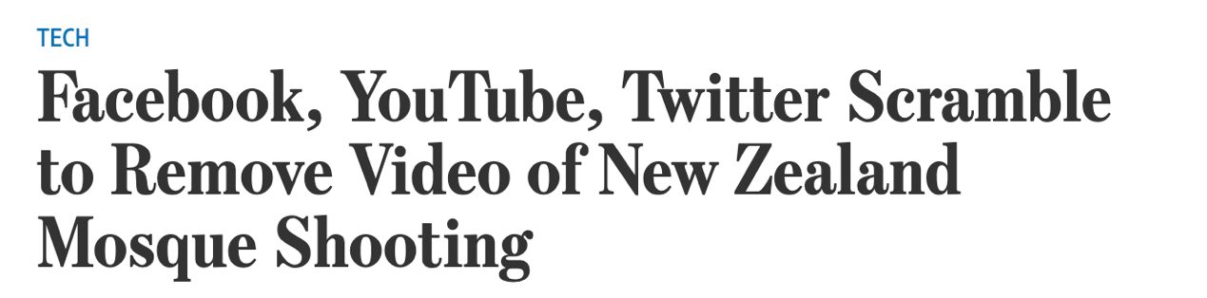
Adversarial examples are a security threat. example: blocking undesired content

Slide 27
We must treat adversarial examples as a computer security problem.
In our threat analysis.
Identify deployed systems where adversarial examples can cause harms beyond misclassification
In our defense evaluations.
Evaluate robustness against adaptive adversaries

Slide 28
We must treat adversarial examples as a computer security problem.
In our defense evaluations.
T, Carlini, Brendel, Madry (NeurIPS 2020)
  empirical study of 13 peer-reviewed defenses (from NeurIPS, ICML, ICLR)
  evaluations are overly complex. Simpler attacks break each defense!
  new crypto-inspired attack: feature collisions

Slide 29

A formal model for evaluating robustness.
Train a model $f(∙)$on a distribution $𝔇$ of labelled inputs $\left(x,y\right)$
The adversary perturbs test inputs $x$ sampled from $𝔇$with noise $δ$
Which perturbations $δ$ do we allow?
  Ideal: any “semantically small” perturbation
ambiguous, hard to formalize

Slide 30
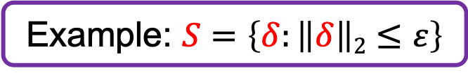
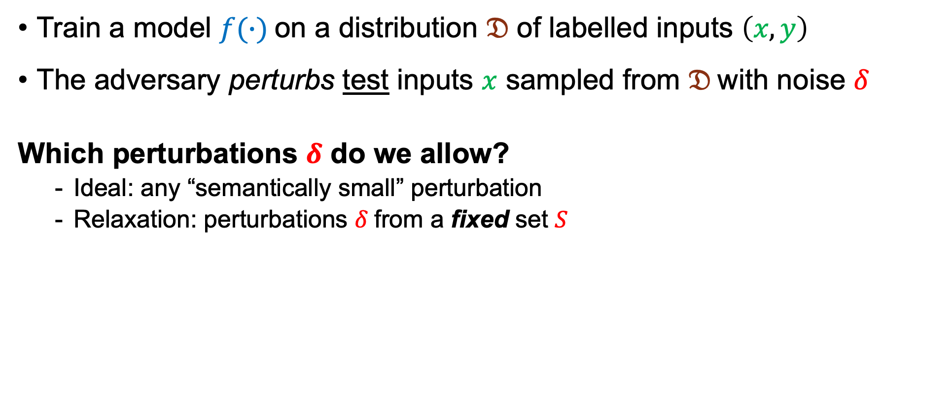
A formal model for evaluating robustness.
Train a model $f(∙)$on a distribution $𝔇$ of labelled inputs $\left(x,y\right)$
The adversary perturbs test inputs $x$ sampled from $𝔇$with noise $δ$
Which perturbations $δ$ do we allow?
  Ideal: any “semantically small” perturbation
  Relaxation: perturbations $δ$from a fixed set $S$
ambiguous, hard to formalize
Example: $S=\left\{δ:\left\|δ\right\|2≤ε\right\}$
necessary but not sufficient

Slide 31
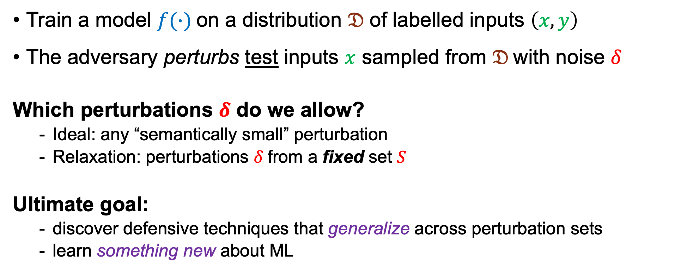
A formal model for evaluating robustness.
Train a model $f(∙)$on a distribution $𝔇$ of labelled inputs $\left(x,y\right)$
The adversary perturbs test inputs $x$ sampled from $𝔇$with noise $δ$
Which perturbations $δ$ do we allow?
  Ideal: any “semantically small” perturbation
  Relaxation: perturbations $δ$from a fixed set $S$
Ultimate goal:
  discover defensive techniques that generalize across perturbation sets
  learn something new about ML
Example: $S=\left\{δ:\left\|δ\right\|2≤ε\right\}$

Slide 32
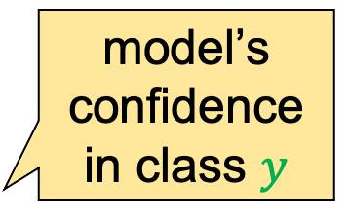
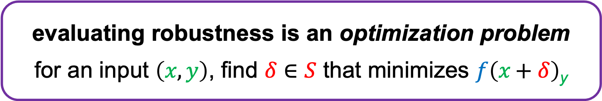
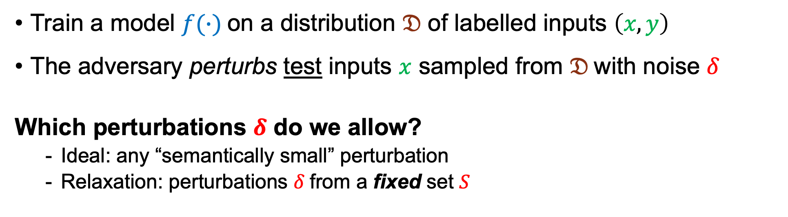
A formal model for evaluating robustness.
Train a model $f(∙)$on a distribution $𝔇$ of labelled inputs $\left(x,y\right)$
The adversary perturbs test inputs $x$ sampled from $𝔇$with noise $δ$
Which perturbations $δ$ do we allow?
  Ideal: any “semantically small” perturbation
  Relaxation: perturbations $δ$from a fixed set $S$
Example: $S=\left\{δ:\left\|δ\right\|2≤ε\right\}$
evaluating robustness is an optimization problem
for an input $\left(x,y\right)$, find $δ∈S$ that minimizes $f\left(x \text{+} δ\right)$_{y}
model’s confidence in class $y$

Slide 33
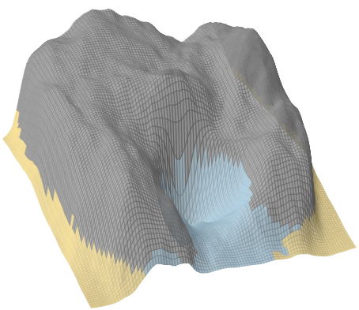
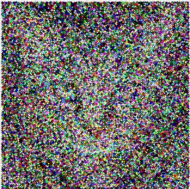
Adversarial examples can be found with gradient descent.
Lynx
confidence in the “Cat” class
Cat
Lynx
Guacamole
Guacamole

Slide 34
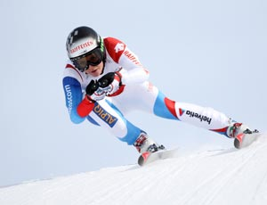
Adversarial examples can be found with gradient descent.
confidence in the “Cat” class
Cat
Lynx
Guacamole

Slide 35
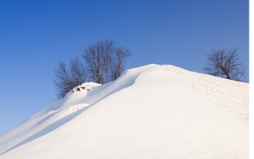

Many defenses break gradient descent.
T et al. (ICLR 2018): defenses can break function smoothness
Other causes of masked gradients:
- numerical instability: [Papernot et al. ‘17], [Carlini & Wagner ‘17]
- stochasticity: [Athalye et al. ‘18]
for most ML models, the optimization problem is easy
(the function is smooth)
many defenses against adversarial examples break the smoothness of the function
this doesn’t make the model more robust!

Slide 36

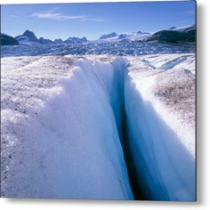
Strong robustness evaluations are adaptive. the optimization strategy is tailored to the defense
[Carlini & Wagner ‘17], [Athalye et al. ‘18], [T et al. ‘20]
defense 1
defense 2
defense 3

Slide 37
Strong robustness evaluations are adaptive. the optimization strategy is tailored to the defense
[Carlini & Wagner ‘17], [Athalye et al. ‘18], [T et al. ‘20]
defense 1
defense 2
defense 3

Slide 38
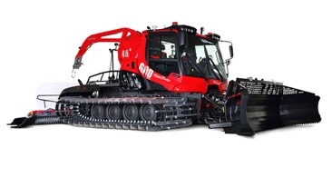
Strong robustness evaluations are adaptive. the optimization strategy is tailored to the defense
[Carlini & Wagner ‘17], [Athalye et al. ‘18], [T et al. ‘20]
defense 1
defense 2
defense 3

Slide 39
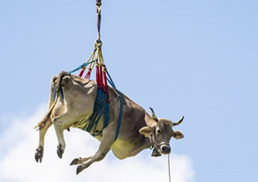
Strong robustness evaluations are adaptive. the optimization strategy is tailored to the defense
[Carlini & Wagner ‘17], [Athalye et al. ‘18], [T et al. ‘20]
defense 1
defense 2
defense 3

Slide 40
Defenses try adaptive evaluations.
T, Carlini, Brendel, Mądry (NeurIPS 2020): evaluation of 13 defenses
claimed accuracy
(over baseline)
Accuracy (%) on adversarial examples
Q: are existing adaptive evaluations effective?

Slide 41
All defenses over-estimate robustness.
T, Carlini, Brendel, Mądry (NeurIPS 2020): evaluation of 13 defenses
claimed accuracy
(over baseline)
Accuracy (%) on adversarial examples
accuracy against our attacks

Slide 42
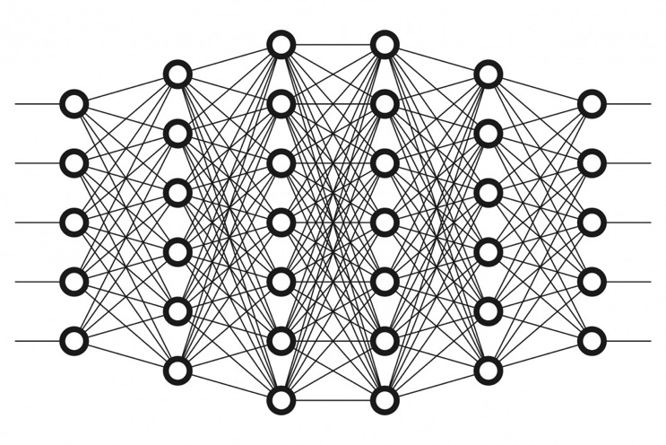
Building stronger adaptive attacks. our target: adversarial examples detectors
“cat”
“On Adaptive Attacks to Adversarial Example Defenses”, NeurIPS 2020

Slide 43

Building stronger adaptive attacks. our target: adversarial examples detectors
internal features
“cat”
I check whether
the input is
perturbed
Detector
“On Adaptive Attacks to Adversarial Example Defenses”, NeurIPS 2020

Slide 44
Building stronger adaptive attacks. our target: adversarial examples detectors
“guacamole”
“On Adaptive Attacks to Adversarial Example Defenses”, NeurIPS 2020

Slide 45
Building stronger adaptive attacks. our target: adversarial examples detectors
internal features
“guacamole”
this input has been tampered with!
Detector
“On Adaptive Attacks to Adversarial Example Defenses”, NeurIPS 2020

Slide 46
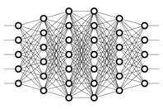
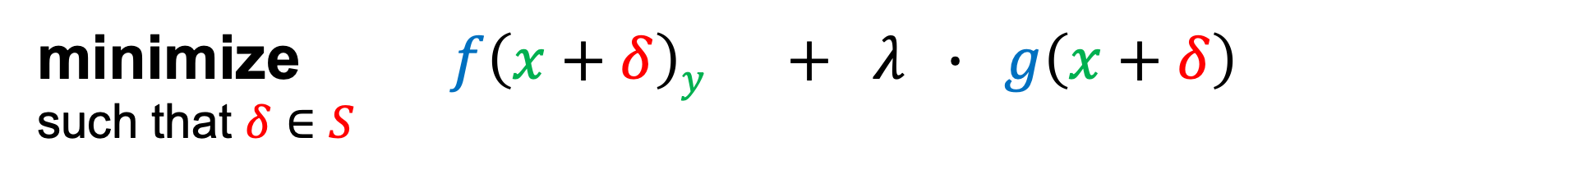
An overly complex adaptive attack.
minimize $f\left(x+δ\right)y + λ ∙ g\left(x+δ\right)$
such that $δ∈S$
confidence that input is invalid
Detector
“On Adaptive Attacks to Adversarial Example Defenses”, NeurIPS 2020

Slide 47

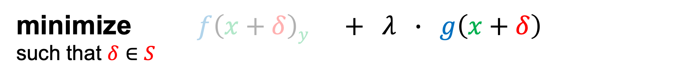
An overly complex adaptive attack.
minimize $f\left(x+δ\right)y + λ ∙ g\left(x+δ\right)$
such that $δ∈S$
Detector
Issue: detectors are often
  stochastic
  discontinuous
  numerically unstable
“On Adaptive Attacks to Adversarial Example Defenses”, NeurIPS 2020

Slide 48
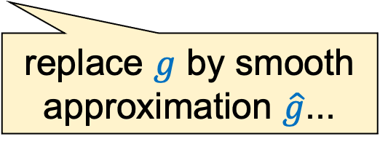
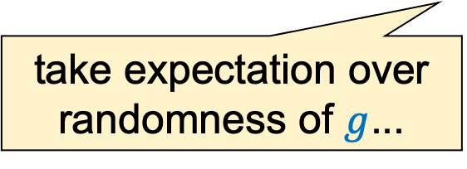
An overly complex adaptive attack.
minimize $f\left(x+δ\right)y + λ ∙ g\left(x+δ\right)$
such that $δ∈S$
take expectation over randomness of $g$...
replace $g$ by smooth approximation $\hat{g}$...
Issue: detectors are often
  stochastic
  discontinuous
  numerically unstable
“On Adaptive Attacks to Adversarial Example Defenses”, NeurIPS 2020

Slide 49
A simpler & stronger attack: feature collisions.
“On Adaptive Attacks to Adversarial Example Defenses”, NeurIPS 2020

Slide 50
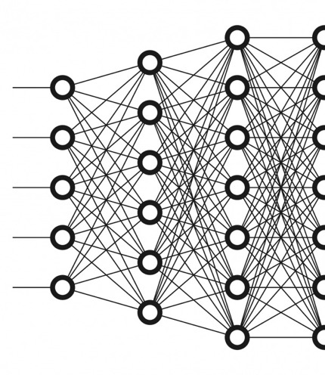
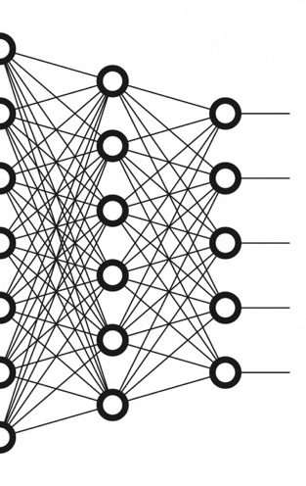

A simpler & stronger attack: feature collisions. insight #1: decompose the system
feature extractor
classifier head
Detector
we’ll attack this part
“On Adaptive Attacks to Adversarial Example Defenses”, NeurIPS 2020

Slide 51
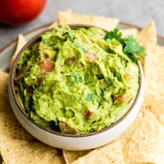
A simpler & stronger attack: feature collisions. insight #2: target a natural input
feature extractor
classifier head
“guacamole”
Detector
this is our attack’s target
“On Adaptive Attacks to Adversarial Example Defenses”, NeurIPS 2020

Slide 52
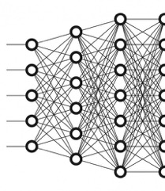

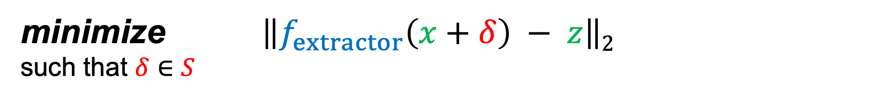
Goal: collide with features of the target input.
[Sabour et al. ‘15]
feature extractors are not collision resistant!
minimize $\left\|f_{extractor}\left(x+δ\right) − z\right\|2$
such that $δ∈S$
internal features of guacamole
“On Adaptive Attacks to Adversarial Example Defenses”, NeurIPS 2020

Slide 53
The feature collision attack. or “garbage-in, garbage-out”
feature extractor
classifier head
“guacamole”
internal features of guacamole
Detector
“On Adaptive Attacks to Adversarial Example Defenses”, NeurIPS 2020

Slide 54
Feature collision is a strong adaptive attack.
claimed accuracy
(over baseline)
Accuracy (%) on adversarial examples
4 defenses are broken with this strategy
accuracy against our attacks
“On Adaptive Attacks to Adversarial Example Defenses”, NeurIPS 2020

Slide 55
Some defenses work.
Adversarial training
Certified defenses
[Szegedy et al. ‘13], [Goodfellow et al. ‘14], [Kurakin et al. ‘16], [T et al. ‘17],
[Madry et al. ‘18], [Zhang et al. ‘19], [Carmon et al. ‘19], [Uesato et al. ‘19],
[Zhai et al. ‘19], [Shafahi et al. ‘19], [Yang et al. ‘19], [Li et al. ‘20], ...
[Katz et al. ‘17], [Wong et al. ‘17], [Raghunathan et al. ‘18], [Gehr et al. ‘18],
[Lecuyer et al. ‘18], [Zhang et al. ‘18], [Mirman et al. ‘18], [Weng et al. ‘19],
[Baluta et al. ‘19], [Cohen et al. ‘19], [Singh et al. ‘19], [Gluch et al. ‘20], ...

Slide 56

Some defenses work, but don’t generalize...
Adversarial training
Certified defenses
recall: we only consider perturbations $δ$from a fixed set $S$
issue: all defenses above are explicitly tailored to a chosen set $S$
[Szegedy et al. ‘13], [Goodfellow et al. ‘14], [Kurakin et al. ‘16], [T et al. ‘17],
[Madry et al. ‘18], [Zhang et al. ‘19], [Carmon et al. ‘19], [Uesato et al. ‘19],
[Zhai et al. ‘19], [Shafahi et al. ‘19], [Yang et al. ‘19], [Li et al. ‘20], ...
[Katz et al. ‘17], [Wong et al. ‘17], [Raghunathan et al. ‘18], [Gehr et al. ‘18],
[Lecuyer et al. ‘18], [Zhang et al. ‘18], [Mirman et al. ‘18], [Weng et al. ‘19],
[Baluta et al. ‘19], [Cohen et al. ‘19], [Singh et al. ‘19], [Gluch et al. ‘20], ...
defenses overfit to the chosen set
T, Behrmann, Carlini, Papernot, Jakobsen
(ICML 2020)
generalizing to richer sets hurts robustness
T & Boneh (NeurIPS 2019 spotlight)

Slide 57

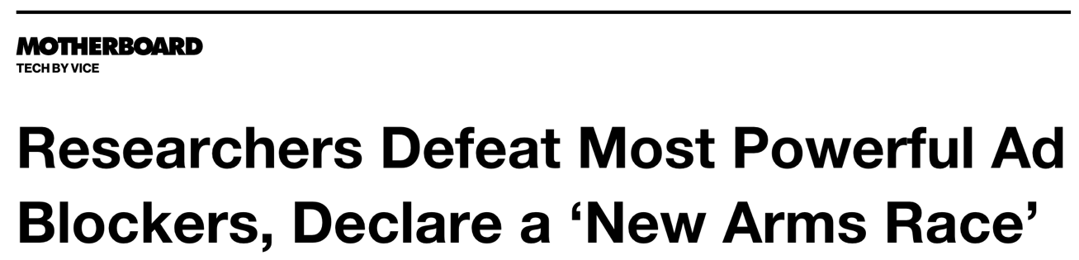
Take away: we don’t have robust machine learning in adversarial settings.

Slide 58

Take away: we don’t have robust machine learning in adversarial settings.
But, we now have:
industry awareness
of security risks
adoption of principled security evaluations

Slide 59
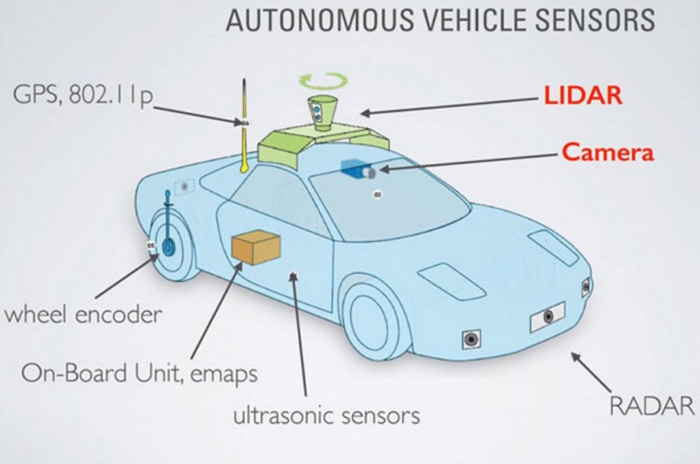
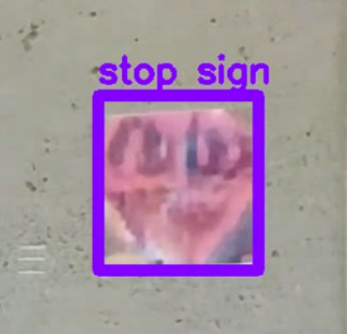
The future: evasion attacks as safety evaluation.
[Pei et al. ‘17], [Tian et al. ‘17], [Gehr et al. ‘18], [Bansal et al. ‘18], [Ma et al. ‘18], [Sun et al. ‘18], ...
use attacks to stress-test ML in safety-critical systems.
our WOOT’18 paper
Notes:
Looking forward, I think that this work on attacking machine learning is also going to become very relevant beyond settings where there is an explicit malicious adversary,
and these attacks are going to be useful as a general way to create worst-case test scenarios for safety critical systems, that already achieve a very high average-case reliability.
<===>To illustrate my point, two years ago we showed that computer vision models could be made to hallucinate a stop sign on a concrete wall.
And here, I don’t really see this as a particularly concerning *attack* vector. If someone wanted to crash your car there’s probably easier things they could do, like throw rocks at it.
Instead, I think that these adversarial examples can be great worst-case tests that can help us to understand how the system as a whole should be designed so as to be resilient to failures in the machine learning models.

Slide 60
My work: measuring and enhancing ML security
Evaluations
Evading ML models (NeurIPS ‘20) (ACM CCS ‘19)
Influenced design changes in Adblock Plus
Extracting private data (IEEE S&P ‘21)
Defenses
Training private models (ICLR ‘21 spotlight)
Training robust models (NeurIPS ‘19 spotlight) (ICLR ‘18)
Deploying private models (ICLR ‘19 oral)
Foundations
Stealing ML models (USENIX ‘16)
Microsoft’s top 3 threats to AI systems
Threat models for evasion (ICML ‘20)

Slide 61

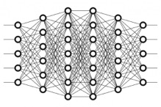

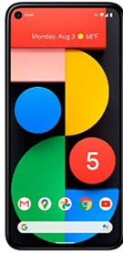


ML models are trained on private data.

Slide 62
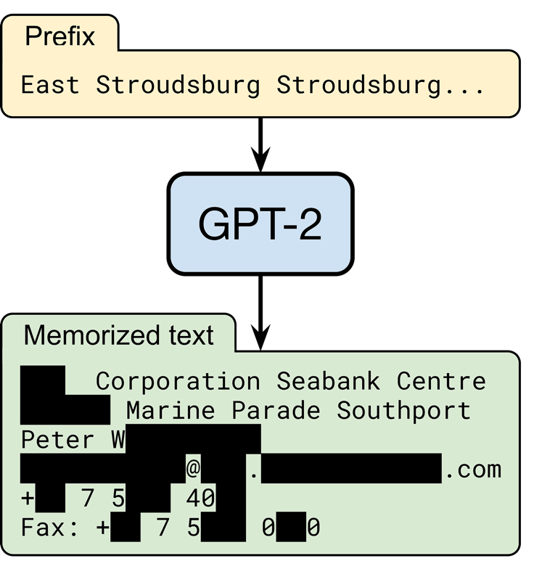
Challenge: models leak their training data.
Carlini, T, Wallace, Jagielski, Herbert-Voss, Lee et al. (preprint 2020)
random input
OpenAI’s language model trained on text from 8 million web pages
someone’s contact information
output by the model
(redacted for privacy)

Slide 63
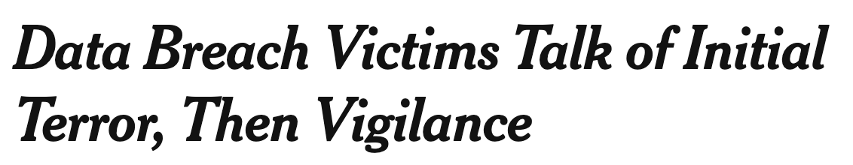



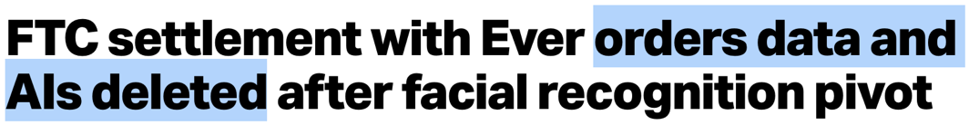
Data leaks have dramatic consequences!
for users...
for companies...

Slide 64
Preventing data leakage with decade-old ML
T & Boneh (ICLR 2021 spotlight)
provably prevent leakage of training data.
using differential privacy
Extensions: distributed or federated learning
[Dean et al. ‘12], [McMahan et al. ‘16], [Lian et al. ‘17]
better accuracy than with deep learning methods.
using domain-specific feature engineering

Slide 65




Differential privacy prevents data leakage.
[Dwork et al. ‘06]
intuition: randomized training algorithm is not influenced (too much) by any individual data point
for any two datasets that differ in a single element
$$\frac{\text{Pr}[Atrain\left( \right)= ]}{\text{Pr}[Atrain\left( \right)= ]}≤e^{ε}$$

Slide 66

Differentially private learning is possible with noisy gradient descent.
Gradient descent
Private gradient descent
[Chaudhuri et al., ‘11], [Bassily et al. ‘14],
[Shokri & Shmatikov ‘15], [Abadi et al. ‘16], ...
add noise to each step to guarantee privacy

Slide 67

Non-private deep learning can achieve near-perfect accuracy.
“deep learning era”

Slide 68
Differentially private deep learning lowers accuracy significantly.
“deep learning era”

Slide 69
Differentially private deep learning lowers accuracy significantly.
−40% accuracy!
worse than pre-deep learning
“deep learning era”

Slide 70
Differential privacy without deep learning improves accuracy.
no deep learning!
“deep learning era”
“Differentially private learning needs better features”, ICLR 2021 spotlight

Slide 71


Privacy-free features from “old-school” image recognition.
SIFT [Lowe ‘99, ‘04], HOG [Dalal & Triggs ‘05], SURF [Bay et al. ‘06], ORB [Rublee et al. ‘11], ...
Scattering transforms: [Bruna & Mallat ‘11], [Oyallon & Mallat ‘14], ...
“handcrafted features”
(no learning involved)
simple classifier
(e.g., logistic regression)
captures some prior about the domain: e.g., invariance under rotation & scaling
privacy free

Slide 72
Handcrafted features lead to a better tradeoff between accuracy and privacy.
Better
“Differentially private learning needs better features”, ICLR 2021 spotlight

Slide 73


Handcrafted features lead to an easier learning task (for noisy gradient descent).
high accuracy classifier exists but learning takes
many gradient steps
in feature space, maximal accuracy is reduced but learning progresses faster
bad for privacy
good for privacy
“Differentially private learning needs better features”, ICLR 2021 spotlight

Slide 74





Learning better privacy-free features from public data.
train a feature extractor on public data...
public data
...transfer and fine-tune on private data
private data
privacy free
“Differentially private learning needs better features”, ICLR 2021 spotlight

Slide 75
With access to a public dataset, privacy comes almost for free!
5% gap!
with unlabeled ImageNet as the public data
“Differentially private learning needs better features”, ICLR 2021 spotlight

Slide 76






Differential private learning in industry.
I added batching support for private gradient descent
I identified and fixed incorrect privacy analyzes

Slide 77
My work: measuring and enhancing ML security
Evaluations
Evading ML models (NeurIPS ‘20) (ACM CCS ‘19)
Influenced design changes in Adblock Plus
Extracting private data (IEEE S&P ‘21)
Defenses
Training private models (ICLR ‘21 spotlight)
Training robust models (NeurIPS ‘19 spotlight) (ICLR ‘18)
Deploying private models (ICLR ‘19 oral)
Foundations
Stealing ML models (USENIX ‘16)
Microsoft’s top 3 threats to AI systems
Threat models for evasion (ICML ‘20)

Slide 78











Can we evaluate neural networks privately?
[Gilad-Bachrach et al. ‘16], [Mohassel et al. ‘17], [Liu et al. ‘17], [Juvekar et al. ‘18], [Hunt et al. ‘18],
[Grover et al. ‘18], ...
input $x$
$$x$$
$$y$$
output $y$
the cloud provider sees all your data!
sensitive applications (e.g., in healthcare) must abide by strict data confidentiality regulations

Slide 79
Slalom: secure cloud deployment of ML
T & Boneh (ICLR 2019 oral)
Different from differential privacy!
here, the model is already trained and we want to protect the test data of users
System goals:
  Confidentiality: cloud provider does not learn user inputs
  Integrity: cloud provider cannot tamper with computation
combines ideas from ML systems, hardware security and
cryptography to protect user data from a malicious cloud.
maximizes use of cloud’s special-purpose hardware.

Slide 80






Baseline: security with slow CPU enclaves.
special purpose hardware (e.g., GPU) provides no security
input $x$
hardware enclave
$$x$$
$$y$$
output $y$
general purpose CPU with enclave
SGX (Intel)
Sanctum, Keystone (RISC-V)
Trustzone (ARM)

Slide 81

Slalom: security with fast custom hardware
Slalom
input $x$
hardware enclave
crypto
$$x$$
$$y$$
output $y$
“Slalom: Fast, Verifiable and Private Execution of Neural Networks in Trusted Hardware”, ICLR 2019 oral

Slide 82



Secure outsourcing of matrix products.
user input
model weights
$$X$$
$$W$$
no confidentiality
$$X$$
$$WX$$
“Slalom: Fast, Verifiable and Private Execution of Neural Networks in Trusted Hardware”, ICLR 2019 oral

Slide 83




Secure outsourcing of matrix products.
quantization!
(compute on integers modulo prime)
$$X∈ℤ_{p}^{n×n}$$
$$W∈ℤ_{p}^{n×n}$$
random mask
$$X+δ$$
precomputed
(independent of input)
$$WX+Wδ$$
“Slalom: Fast, Verifiable and Private Execution of Neural Networks in Trusted Hardware”, ICLR 2019 oral

Slide 84

Secure outsourcing of matrix products.
$$X∈ℤ_{p}^{n×n}$$
$$W∈ℤ_{p}^{n×n}$$
no integrity!
$$X+δ$$
garbage
“Slalom: Fast, Verifiable and Private Execution of Neural Networks in Trusted Hardware”, ICLR 2019 oral

Slide 85


Secure outsourcing of matrix products.
$$X∈ℤ_{p}^{n×n}$$
$$W∈ℤ_{p}^{n×n}$$
Probabilistic check
$$(Z−Wδ)r≟W(Xr)$$
$O(n2)$instead of $O(n3)$
$$X+δ$$
$$Z$$
“Slalom: Fast, Verifiable and Private Execution of Neural Networks in Trusted Hardware”, ICLR 2019 oral

Slide 86




Secure outsourcing of matrix products.
$$X∈ℤ_{p}^{n×n}$$
$$W∈ℤ_{p}^{n×n}$$
Theorem (informal):
Assuming a secure PRNG, Slalom guarantees confidentiality and integrity (with soundness error $k/p$ for a $k$-layer neural network).
Probabilistic check
$$(Z−Wδ)r≟W(Xr)$$
$O(n2)$instead of $O(n3)$
$$X+δ$$
$$Z$$
“Slalom: Fast, Verifiable and Private Execution of Neural Networks in Trusted Hardware”, ICLR 2019 oral

Slide 87


Slalom improves secure inference throughput.
Intel SGX ⬌ Nvidia Titan XP
ImageNet inference throughput (images per second)
Goal: Slalom (Enclave⬌GPU) ≫ Enclave_{baseline}
execute entire model in secure enclave
throughput relative to baseline
Better
Slalom
baseline
“Slalom: Fast, Verifiable and Private Execution of Neural Networks in Trusted Hardware”, ICLR 2019 oral

Slide 88
My work: measuring and enhancing ML security
Evaluations
Evading ML models (NeurIPS ‘20) (ACM CCS ‘19)
Influenced design changes in Adblock Plus
Extracting private data (IEEE S&P ‘21)
Defenses
Training private models (ICLR ‘21 spotlight)
Training robust models (NeurIPS ‘19 spotlight) (ICLR ‘18)
Deploying private models (ICLR ‘19 oral)
Foundations
Stealing ML models (USENIX ‘16)
Microsoft’s top 3 threats to AI systems
Threat models for evasion (ICML ‘20)

Slide 89



Future work
ML security is a critical challenge for our society.
Evaluations
Defenses
robustness
fairness
[T et al. ‘17]
interpretability
Formal foundations for trustworthy ML.
A framework as beautiful as differential privacy for other critical safety properties
Foundations

Slide 90


Future work
ML security is a critical challenge for our society.
Evaluations
Defenses
Cryptography for ML.
Making machine learning secure against computationally-bounded adversaries
Foundations

Slide 91


Future work
ML security is a critical challenge for our society.
Evaluations
Defenses
Vetting ML safety in critical applications.
Evaluating the failure modes of models once they reach 99.999% accuracy
Foundations

Slide 92
Conclusion
ML is currently not trustworthy.
  it is not robust.
  it is not private.
We can get better robustness than current ML.
  humans are an existence proof.
  we must approach this as a security problem.
We can get better privacy than current ML.
  with differential privacy and cryptography.

Slide 93
Conclusion
ML is currently not trustworthy.
  it is not robust.
  it is not private.
We can get better robustness than current ML.
  humans are an existence proof.
  we must approach this as a security problem.
We can get better privacy than current ML.
  with differential privacy and cryptography.
Thank you!

