Slide 1
A Tour of Machine Learning Security
Florian Tramèr
CISPA
August 6th 2018

Slide 2
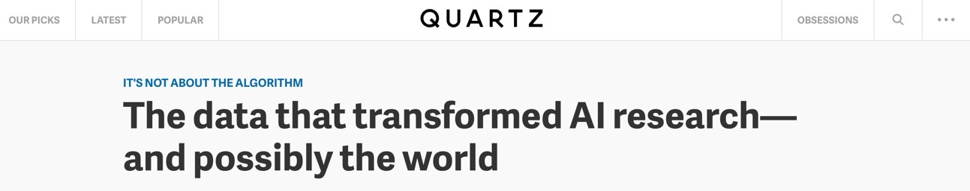
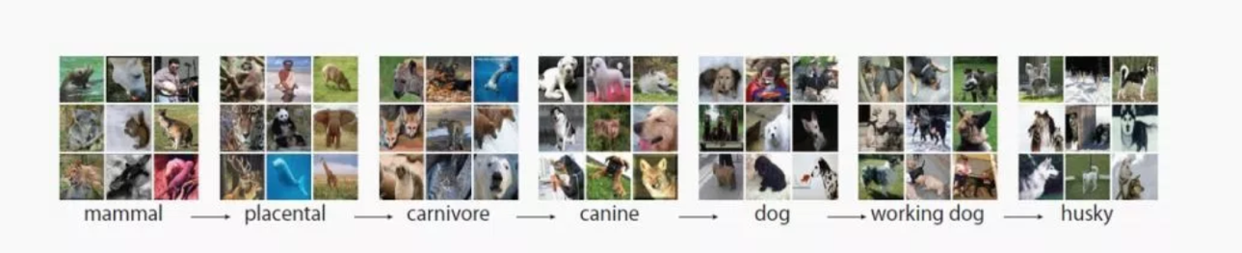
The Deep Learning Revolution
  First they came for images…
Notes:
For about 5 years, we’ve witnessed a deep learning revolution. All started with images

Slide 3
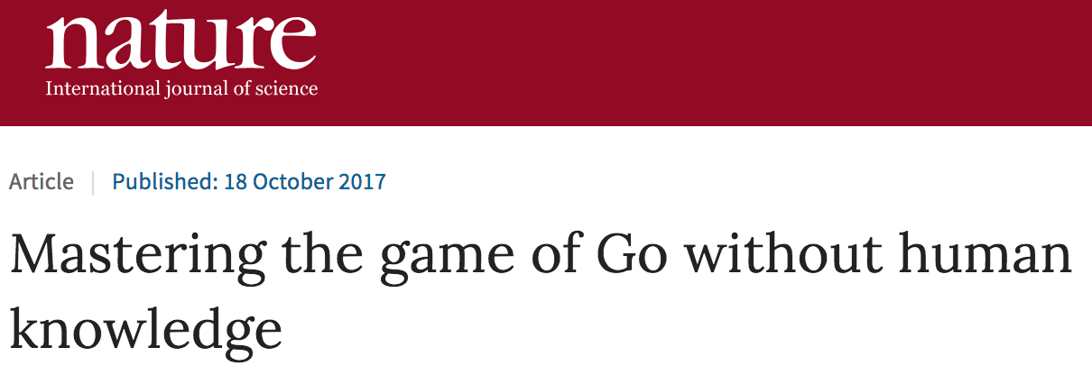
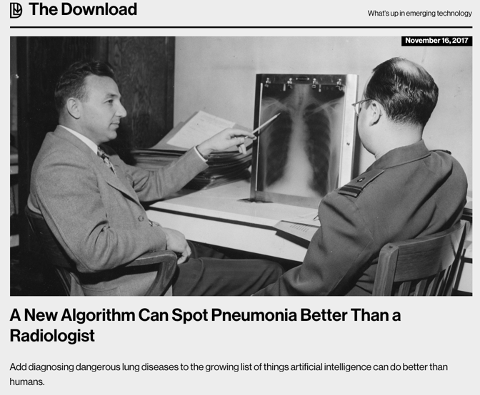
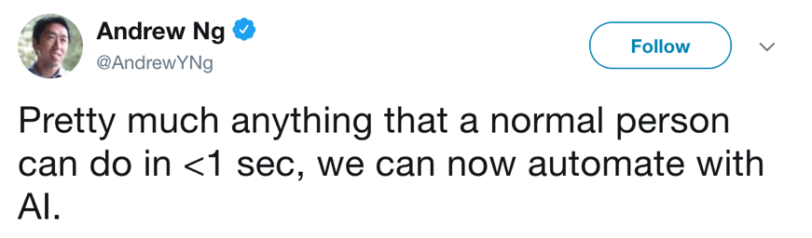
The Deep Learning Revolution
  And then everything else…
Notes:
But quickly spread to diverse areas such as game playing, self-driving cars, medicine. And not clear where this trend will end
Striking quote by Andres Ng: optimistic but sentiment is compelling

Slide 4

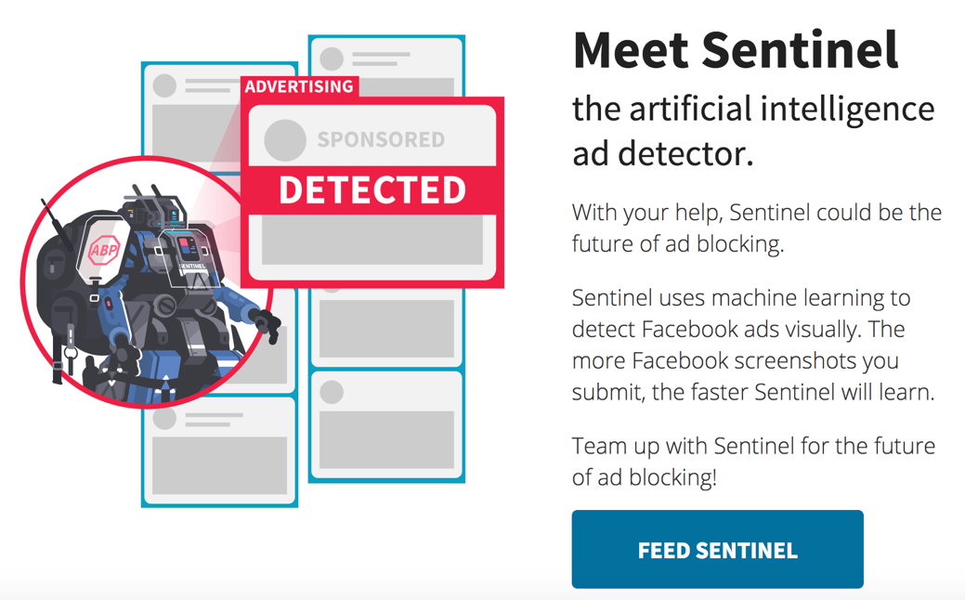
The ML Revolution
  Including things that likely won’t work…
Notes:
This view is challenged when ML is applied to security sensitive areas
Recent example: using ML to detect and block facebook ads

Slide 5
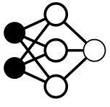


What does this mean for privacy & security?
Crypto, Trusted hardware
Differential privacy
Privacy & integrity
Outsourced learning
Data inference
Model theft
Test outputs
Training data
Data poisoning
Blockchain
???
dog
cat
bird
Robust statistics
Adversarial
examples
Outsourced inference
Test data
Privacy & integrity
Crypto, Trusted hardware
Adapted from (Goodfellow 2018)
Notes:
What does this revolution mean for privacy/security researchers: A rich pipeline with hard problems at every step

Slide 6
This talk: security of deployed models
Crypto, Trusted hardware
Differential privacy
Privacy & integrity
Outsourced learning
Data inference
Model theft
Test outputs
Training data
Data poisoning
???
dog
cat
bird
Robust statistics
Adversarial
examples
Outsourced inference
Test data
Privacy & integrity
Crypto, Trusted hardware

Slide 7
Stealing ML Models
Crypto, Trusted hardware
Differential privacy
Privacy & integrity
Outsourced learning
Data inference
Model theft
Test outputs
Training data
Data poisoning
???
dog
cat
bird
Robust statistics
Adversarial
examples
Outsourced inference
Test data
Privacy & integrity
Crypto, Trusted hardware

Slide 8




Machine Learning as a Service
Goal 2: Model Confidentiality
Model/Data Monetization
Sensitive Data
Model f
Prediction API
Training API
input
classification
Data
Black Box
Goal 1: Rich Prediction APIs
Highly Available
High-Precision Results
$$$ per query

Slide 9
Model Extraction
Goal: Adversarial client learns close approximation of f using as few queries as possible
Applications:
Undermine pay-for-prediction pricing model
”White-box” attacks:
    Infer private training data
    Model evasion (adversarial examples)
Attack
x
Model f
Data
f’
f(x)

Slide 10
Model Extraction
Goal: Adversarial client learns close approximation of f using as few queries as possible
Attack
x
Model f
Data
f’
f(x)
No! Prediction APIs return fine-grained information that makes extracting much easier than learning
Isn’t this “just Machine Learning”?

Slide 11
Learning vs Extraction
 | Learning f(x) | Extracting f(x)
Function to learn | Noisy real-world phenomenon | “Simple” deterministic function f(x)

Slide 12
Learning vs Extraction
 | Learning f(x) | Extracting f(x)
Function to learn | Noisy real-world phenomenon | “Simple” deterministic function f(x)
Available labels | hard labels (e.g., “cat”, “dog”, …) | Depending on API: Hard labels Soft labels (class probas) Gradients (for interpretability)

Slide 13
Learning vs Extraction
 | Learning f(x) | Extracting f(x)
Function to learn | Noisy real-world phenomenon | “Simple” deterministic function f(x)
Available labels | hard labels (e.g., “cat”, “dog”, …) | Depending on API: Hard labels Soft labels (class probas) Gradients (Milli et al.)
Labeling function | Humans, real-world data collection | Query f(x) on any input x => No need for labeled data => Queries can be adaptive

Slide 14
Learning vs Extraction for specific models
 | Learning f(x) | Extracting f(x)
Logistic Regression | |Data| ≈ 10 * |Features| | Hard labels only: (Loyd & Meek) With confidences: simple system of equations (T et al.) |Data| = |Features| + cte

Slide 15
Learning vs Extraction for specific models
 | Learning f(x) | Extracting f(x)
Logistic Regression | |Data| ≈ 10 * |Features| | Hard labels only: (Loyd & Meek) With confidences: simple system of equations (T et al.) |Data| = |Features| + cte
Decision Trees | NP-hard in general polytime for Boolean trees (Kushilevitz & Mansour) | “Differential testing” algorithm to recover the full tree (T et al.)

Slide 16
Learning vs Extraction for specific models
 | Learning f(x) | Extracting f(x)
Logistic Regression | |Data| ≈ 10 * |Features| | Hard labels only: (Loyd & Meek) With confidences: simple system of equations (T et al.) |Data| = |Features| + cte
Decision Trees | NP-hard in general polytime for Boolean trees (Kushilevitz & Mansour) | “Differential testing” algorithm to recover the full tree (T et al.)
Neural Networks | Large models required “The more data the better” | Distillation (Hinton et al.) Make smaller copy of model from confidence scores Extraction from hard labels (Papernot et al., T et al.)
No quantitative analysis for large neural nets yet

Slide 17
Crypto, Trusted hardware
Differential privacy
Privacy & integrity
Outsourced learning
Data inference
Model theft
Test outputs
Training data
Data poisoning
???
dog
cat
bird
Robust statistics
Adversarial
examples
Outsourced inference
Test data
Privacy & integrity
Crypto, Trusted hardware

Slide 18



Trusted execution of ML: 3 motivating scenarios
Cloud ML APIs
Data Privacy
Integrity
Model “downgrade”
Disparate impact
Other malicious tampering

Slide 19


Trusted execution of ML: 3 motivating scenarios
Federated Learning
Integrity
Poison model updates
Data privacy

Slide 20

Trusted execution of ML: 3 motivating scenarios
Trojaned hardware
(Verifiable ASICs model, Wahby et al.)
Integrity

Slide 21
Solutions
Cryptography / Statistics
    Outsourced ML: FHE, MPC, (ZK) proof systems
    Federated learning: robust statistics?
    Trojaned hardware: some root of trust is needed
Trusted Execution Environments (TEEs)
    Outsourced ML: secure enclaves
    Federated learning: trusted sensors + secure enclaves
    Trojaned hardware: fully trusted (but possibly slow) hardware

Slide 22
Trusted Execution: At what cost?
Trusted ASICs (Wahby et al.): ~10⁸×worse than SOTA
Intel SGX:
Paging at ~90MB
GPU: Nvidia TITAN XP
SGX: Intel Core i7-6700 Skylake Single Core @ 3.40GHz
https://medium.com/@danny_harnik/impressions-of-intel-sgx-performance-22442093595a

Slide 23
“How do we efficiently leverage TEEs for secure machine learning computations?”
Idea: outsource work to collocated, faster but untrusted device and verify results
x
TEE
F(x), proof
 | Computations | Gap between trusted and untrusted device | Privacy
Verifiable ASICs (Wahby et al., 2016) | Arithmetic circuits (GKR protocol) | ~ 8 orders of magnitude | No
Slalom | DNN inference | ~ 1-2 orders | “Yes”
Not in this talk
Notes:
Prover + verifier << verifier performs computation himself => very hard to achieve for arbitrary circuits
Bottleneck will be verifier complexity, not prover overhead

Slide 24
Bottlenecks in deep neural networks
non linear stuff (cheap)
MATRIX MULTIPLICATION
~ 97%
VGG16 Inference on 1 CPU core

Slide 25
Outsourcing matrix multiplication: Freivald’s algorithm
Input: X ∈ 𝔽^{n ⨉ n} , W ∈ 𝔽^{n ⨉ n}
Direct Compute: Z = X * W
≈ n³ multiplications or O(n^{2.81}) with Strassen
Outsource + Verify:
    Sample r ← 𝔽^{n} uniformly at random
    Check: Z * r = X * (W * r)
    Complexity: ≈ 3n² multiplications
    Soundness: 1 / | 𝔽 | (boost by repeating)
DNN weights. Fixed at inference time

Slide 26
Freivald variants for arbitrary linear operators
Matrix of size |x| × |z|
Linear operator: z = F(x) = x * A
Batched verification
    Z = F([x₁ … x_{B}]) = [F(x₁) … F(x_{B})] ⇒ Complexity = B*cost(F)
    Freivald: r * Z = F(r * [x₁ … x_{B}]) ⇒ Complexity = B*(|x|+|z|) + cost(F)
With precomputation
    Precompute A’ = A * r = (∇_{x} F)(r)
    Freivald: z * r = x * A’ ⇒ Complexity = |x|+|z|
Vector of size |z|
Vector of size |x|
2 inner products!

Slide 27
Slalom Summary
Slalom
TEE
X₁
Z₁ = X₁ * W₁
Freivald check for (X₁, W₁, Z₁)
X₂ = σ(Z₁)
X₂
Arbitrary non-linearity
Z₂ = X₂ * W₂
…

Slide 28

Design and Evaluation
TEE
  TEE: Intel SGX ”Desktop” CPU (single thread)
  Untrusted device: Nvidia Tesla GPU
  Port of the Eigen linear algebra C++ library to SGX
  (used in e.g., TensorFlow)
  No simulation mode!

Slide 29
Crypto, Trusted hardware
Differential privacy
Privacy & integrity
Outsourced learning
Data inference
Model theft
Test outputs
Training data
Data poisoning
???
dog
cat
bird
Robust statistics
Adversarial
examples
Outsourced inference
Test data
Privacy & integrity
Crypto, Trusted hardware

Slide 30
ML models make surprising mistakes
Pretty sure this is a panda
I’m certain this is a gibbon
(Szegedy et al. 2013, Goodfellow et al. 2015)

Slide 31
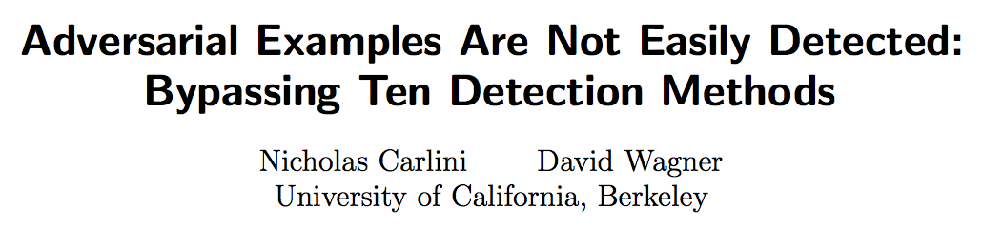
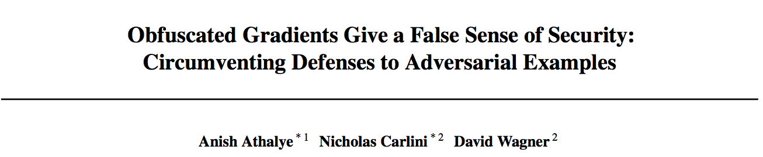
Where are the defenses?
Adversarial training
Szegedy et al. 2013, Goodfellow et al. 2015,
Kurakin et al. 2016, T et al. 2017,
Madry et al. 2017, Kannan et al. 2018
Convex relaxations with provable guarantees
Raghunathan et al. 2018, Kolter & Wong 2018, Sinha et al. 2018
A lot of broken defenses…
Prevent “all/most attacks” for a given norm ball
Notes:
Adversarial training: basically worst-case data augmentation under a given attack model. Past year has seen some first cool examples of provable defenses
9min + 3min at this point

Slide 32
Do we have a realistic threat model? (no…)
Current approach:
    Fix a ”toy” attack model (e.g., some l∞ ball)
    Directly optimize over the robustness measure
      Defenses do not generalize to other attack models
      Defenses are meaningless for applied security
What do we want?
    Model is “always correct” (sure, why not?)
    Model has blind spots that are “hard to find”
      “Non-information-theoretic” notions of robustness?
      CAPTCHA threat model is interesting to think about
Notes:
Norm balls are intellectually / academically interesting (i.e., even this is hard), but pretty irrelevant in practice
Conservative measure of perceptual similarity (low norm implies perceptual similarity)

Slide 33
Adversarial examples are here to stay!
For many things that humans can do “robustly”, ML will fail miserably!

Slide 34

A case study on ad blocking
Ad blocking is a “cat & mouse” game
    Ad blockers build crowd-sourced filter lists
    Ad providers switch origins
    Rinse & repeat
  (4?) Content provider (e.g., Cloudflare) hosts the ads
Notes:
Ad blocking currently: mostly no ML, detecting origin of ads, rule-based
+ 3min

Slide 35

A case study on ad blocking
New method: perceptual ad-blocking (Storey et al. 2017)
    Industry/legal trend: ads have to be clearly indicated to humans
If humans can detect ads, so can ML!
”[…] we deliberately ignore all signals invisible to humans, including URLs and markup. Instead we consider visual and behavioral information. […] We expect perceptual ad blocking to be less prone to an "arms race."
(Storey et al. 2017)
Notes:
New idea: mirror the way humans detect ads (remember Andrew NG’s tweet, <1sec)
Storey, Reisman, Mayer, Narayanan

Slide 36
How to detect ads?
“DOM based”
  Look for specific ad-cues in the DOM
  E.g., fuzzy hashing, OCR (Storey et al. 2017)
Machine Learning on full page content
  Sentinel approach: train object detector (YOLO) on annotated screenshots
Notes:
All examples of ad-choice logos found in the wild. Different dimensions, spacing, coloring, transparency, text or no text etc.
Difficult to brute-force
YOLO => method used by Sentinel
+ 4min

Slide 37
What’s the threat model for perceptual ad-blockers?
Browser
Vivamus vehicula leo a justo. Quisque nec augue. Morbi mauris wisi, aliquet vitae, dignissim eget, sollicitudin molestie,
Content provider
Webpage
Vivamus vehicula leo a justo. Quisque nec augue. Morbi mauris wisi, aliquet vitae, dignissim eget, sollicitudin molestie,
Ad blocker
Ad network

Slide 38



What’s the threat model for perceptual ad-blockers?
1. False Negatives
Browser
Vivamus vehicula leo a justo. Quisque nec augue. Morbi mauris wisi, aliquet vitae, dignissim eget, sollicitudin molestie,
Content provider
Webpage
Vivamus vehicula leo a justo. Quisque nec augue. Morbi mauris wisi, aliquet vitae, dignissim eget, sollicitudin molestie,
Ad blocker
Ad network
Notes:
Ad provider has incentive for ad blocker to fail, without impacting human perception of the ad: classical adversarial example problem

Slide 39

What’s the threat model for perceptual ad-blockers?
2. False Positives (“DOS”)
Browser
Vivamus vehicula leo a justo. Quisque nec augue. Morbi mauris wisi, aliquet vitae, dignissim eget, sollicitudin molestie,
Content provider
Webpage
Vivamus vehicula leo a justo. Quisque nec augue. Morbi mauris wisi, aliquet vitae, dignissim eget, sollicitudin molestie,
Ad blocker
Ad network
Notes:
Content provider has incentive to “punish” adblock users (as with adblock-blockers today). Ad blocker has to be robust to adversarial changes in benign content as well.

Slide 40
What’s the threat model for perceptual ad-blockers?
3. Resource exhaustion (for DOM-based techniques)
Webpage
Content provider
Ad blocker
Vivamus vehicula leo a justo. Quisque nec augue. Morbi mauris wisi, aliquet vitae, dignissim eget, sollicitudin molestie,
Ad network
Notes:
Content provider has incentive to “punish” adblock users (as with adblock-blockers today). Ad blocker has to be robust to adversarial changes in benign content as well.

Slide 41
What’s the threat model for perceptual ad-blockers?
Pretty much the worst possible!
  Ad blocker is white-box (browser extension)
    Alternative would be a privacy & bandwidth nightmare
  Ad blocker operates on (large) digital images
    Or can exhaust resources by injecting many small elements
  Ad blocker needs to resist adversarial false positives and false negatives
    Perturb ads to evade ad blocker
    Punish ad-block users by perturbing benign content
  Updating is more expensive than attacking
Notes:
Adblocking ticks all the boxes that make crafting adversarial examples easy
+4min

Slide 42
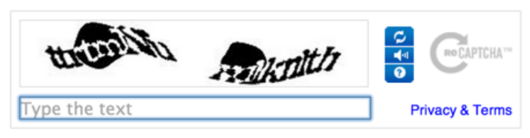
An interesting contrast: CAPTCHAs
Deep ML models can solve text CAPTCHAs
    Why don’t CAPTCHAs use adversarial examples?
    CAPTCHA ≃ adversarial example for OCR systems
 | Model access | Vulnerable to false positives, resource exhaustion | Model Updates
Ad blocker | White-box | Yes | Expensive
CAPTCHA | “Black-box” (not even query access) | No | Cheap (None)
Notes:
Text CAPTCHAS have fallen out of fashion

Slide 43


Attacks on perceptual ad-blockers
DOM-based
    Facebook already obfuscates text indicators!
    Cat & mouse game on text obfuscation
    Final step: use a picture of text
    Dealing with images is hard(er)
      Adversarial examples
      DOS (e.g., OCR on 100s of images)
 | Original | False positive | False negative
OCR
Fuzzy hashing

Slide 44
Attacks on perceptual ad-blockers
  ML based
    YOLO to detect AdChoice logo
    YOLO to detect ads “end-to-end” (it works!)

Slide 45
Conclusions
ML revolution ⇒ rich pipeline with interesting security & privacy problems at every step
Model stealing
    One party does the hard work (data labeling, learning)
    Copying the model is easy with rich prediction APIs
    Model monetization is tricky
  Slalom
    Trusted hardware solves many problems but is “slow”
    Export computation from slow to fast device and verify results
  Perceptual ad blocking
    Mimicking human perceptibility is very challenging
    Ad blocking is the “worst” possible threat model for ML
THANKS

